Slide 1
About ARP spoofing
Key Features
Flowchart
Process
ARP
Spoofing

Slide 2
About ARP Spoofing :
ARP Spoofing also called ARP Poisoning is a type of network attack where a hacker sends fake ARP messages on a local network. The goal is to trick devices into thinking the attacker’s MAC address belongs to another device, like the router or gateway. This way, the attacker can control the flow of network traffic and see or change data being sent between two devices.
It’s mostly used in Man-in-the-Middle (MITM) attacks, where the attacker can read, change, or block data between a user and the network.
Standards

Slide 3
Key Features
• Traffic Sniffing:
Lets the attacker see network traffic between the victim and the router.
• Session Hijacking:
The attacker can take over active sessions.
• Stealing Credentials:
Can be used to grab usernames, passwords and other private data.
• Data Manipulation:
Allows the attacker to add or change information in the data being sent.
• Network Disruption:
Can break communication between devices or cause a denial of service(DoS).

Slide 4
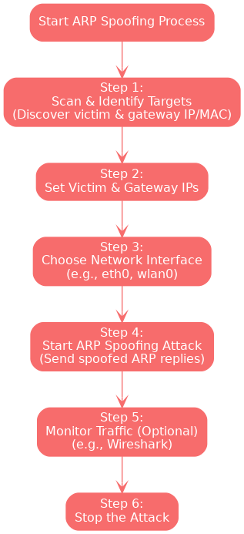
Flowchart

Slide 5
Process
Step 1: Find Your Targets : • First, use a tool like Nmap to find the IP and MAC addresses of devices on your network.
Example: 192.168.1.10, Gateway - 192.168.1.1 Step 2: Enter Ips : • Enter the IP addresses of the victim device and the default gateway.
Step 3: Choose Your Network Interface : • Select the interface that will be used for the spoofing, such as eth0 or wlan0.
Step 4: Start ARP Spoofing Attack : • Click start to begin spoofing. The tool will send fake ARP replies to redirect the traffic through your system.
Step 5: Watch the Traffic (Optional) :
• You can use tools like Wireshark or Tcpdump to look at the captured traffic.
Click on the model to interact

Slide 6
2. Relation between Earth, Sun, and Moon
Step 6: Stop the Attack :
• Once you’re done testing, stop the spoofing to return everything to normal.
Let's look at an example:
• arpspoof -i eth0 -t 192.168.1.10 192.168.1.1
Now lets breakdown the command:-
• -i eth0: Use the eth0 network interface.
• -t 192.168.1.10: The target device (victim).
• 192.168.1.1: The gateway or router being spoofed.
To spoof both directions (victim and router), you can run another command with the IPs reversed.

